Slide 1

Supervised Learning Algorithms
Agenda
Decision Tree
Decision Tree for Regression
Decision Tree for Classification
Advantages & Disadvantages

Slide 2
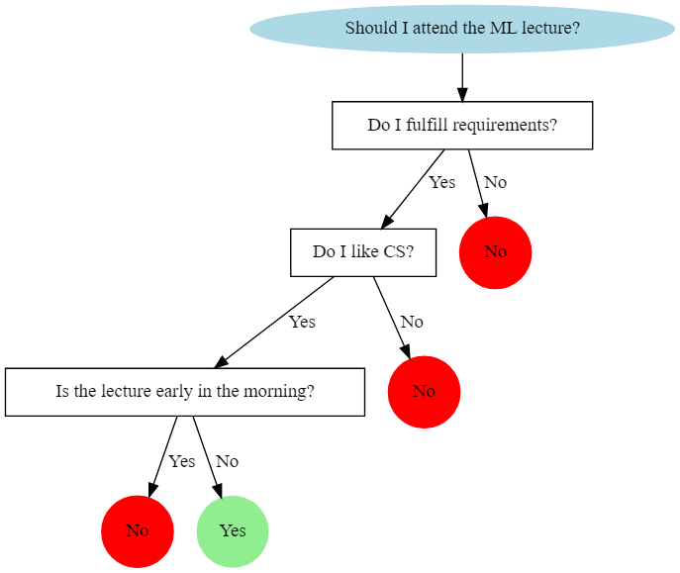
Introduction to Decision Trees
A tree-based model used for regression & classification.
Mimics human decision-making by breaking down problems into simpler decisions.
Works well with both numerical & categorical data.

Slide 3
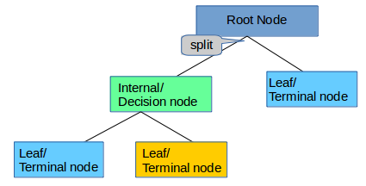
Decision Tree Structure
Root Node: Starting point of the decision.
Decision Nodes: Intermediate steps based on conditions.
Leaf Nodes: Final output (class or value).
Depth of Tree: Number of decision layers.

Slide 4
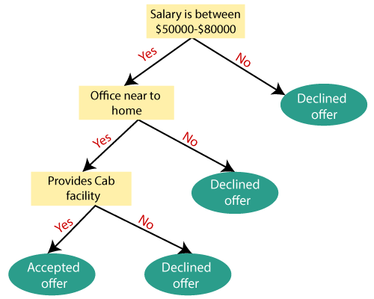
How Decision Trees Work
Recursive partitioning of data into subsets.
Selects the best feature to split at each step.
Repeats the process until a stopping condition is met.

Slide 5

Splitting Criteria – Gini Impurity
What is Gini Impurity?
Gini Impurity is a measure of how mixed the classes are in a dataset. A lower Gini value means the dataset is purer (i.e., contains mostly one class).
The formula for Gini Impurity:
where:
C = number of classes
Pi = proportion of data points belonging to class i

Slide 6
Splitting Criteria – Gini Impurity
Sample Data:
Feature 1 | Feature 2 | Feature 3 | Target (Class)
Sunny | Hot | High | No (0)
Sunny | Hot | High | No (0)
Overcast | Hot | High | Yes (1)
Rainy | Mild | High | Yes (1)
Rainy | Cool | Normal | Yes (1)
Rainy | Cool | Normal | No (0)
Overcast | Cool | Normal | Yes (1)
Sunny | Mild | High | No (0)
Sunny | Cool | Normal | Yes (1)
Rainy | Mild | Normal | Yes (1)
Total samples = 10 Classes: Yes (1) and No (0)

Slide 7
Compute Gini Impurity for the Root Node
We first calculate the Gini impurity for the entire dataset before any split.
Class | Count | Probability p | p2
No (0) | 4 | 4/10=0.4 | 0.16
Yes (1) | 6 | 6/10=0.6 | 0.36
Gini=1−(0.16+0.36)=1−0.52=0.48

Slide 8
Splitting on "Feature 1"
Now, we split the data into three groups based on "Feature 1".
Subset 1: Sunny
Subset 2: Overcast
Subset 3: Rainy
Target | Count
No (0) | 3
Yes (1) | 1
Target | Count
No (0) | 0
Yes (1) | 2
Target | Count
No (0) | 1
Yes (1) | 3
p0​=3/4=0.75, p1​=1/4=0.25
p 0​ =0, p 1​ =2/2=1
p 0​ =1/4=0.25, p 1​ =3/4=0.75
Gini Sunny​ = 1−(0.75 2 +0.25 2)
=1−(0.5625+0.0625)=0.375
Gini Overcast​ =1−(1 2 +0 2)
=1−1=0
Gini Rainy​ =1−(0.25 2 +0.75 2)
=1−(0.0625+0.5625)=0.375

Slide 9
Compute Gini Gain
We compute the weighted Gini impurity after the split:
Gini split​ = 4/10​ (0.375)+ 2/10​ (0)+ 4/10​ (0.375)
=0.15+0+0.15=0.30
GiniGain​ = Giniroot ​− Ginisplit​
=0.48−0.30=0.18
Before splitting: Gini impurity was 0.48.
After splitting on "Weather": Weighted impurity dropped to 0.30.
Gini Gain = 0.18, meaning this split improves purity of the dataset.
This process is repeated for all features, and the feature with maximum Gini Gain is chosen as the first split.

Slide 10

Splitting Criteria – Entropy
What is Entropy?
Entropy is a measure of uncertainty or disorder in a dataset. In Decision Trees, entropy is used to determine the best feature to split the data. A lower entropy means the dataset is purer, while a higher entropy means more randomness.
The formula for Entropy is:
where:
C = number of classes
pi​ = proportion of data points belonging to class i

Slide 11
Compute Entropy for the Root Node
We calculate the entropy of the whole dataset before any split.
Class | Count | Probability p | p2
No (0) | 4 | 4/10=0.4 | −0.4log2​(0.4)
Yes (1) | 6 | 6/10=0.6 | −0.6log2​(0.6)
Using logarithm calculations:
−(0.4×−1.32)−(0.6×−0.737)
=0.528+0.442=0.97
So, Entropy (Root) = 0.97

Slide 12
Splitting on "Feature 1"
We split the data into three subsets based on "Weather.“
Subset 1: Sunny
Subset 2: Overcast
Subset 3: Rainy
Target | Count
No (0) | 3
Yes (1) | 1
Target | Count
No (0) | 0
Yes (1) | 2
Target | Count
No (0) | 1
Yes (1) | 3
p0​=3/4=0.75, p1​=1/4=0.25
p 0​ =0, p 1​ =2/2=1
p 0​ =1/4=0.25, p 1​ =3/4=0.75
= −(0.75log2​0.75)−(0.25log2​0.25)
= −(0.75×−0.415)−(0.25×−2)
= 0.311+0.5
= 0.81
= −(1×log2​1)
= 0
= −(0.25log2​0.25)−(0.75log2​0.75)
= 0.5+0.311=0.81

Slide 13
Compute Information Gain
We compute the weighted entropy after the split:
Entropysplit​ = 4/10​ (0.81)+ 2/10​ (0)+ 4/10​ (0.81)
=0.324+0+0.324=0.648
Information Gain​ = Entropyroot ​− Entropysplit​
=0.97−0.648=0.322
Before splitting: Entropy was 0.97.
After splitting on "Weather": Weighted entropy dropped to 0.648.
Information Gain = 0.322, meaning this split reduces uncertainty in the dataset.
The feature with the highest Information Gain is chosen as the first split in the Decision Tree.
We repeat this process recursively for each branch until we reach pure nodes.

Slide 14

Mean Squared Error (MSE) Split
Decision Tree Regression splits data by minimizing an error metric such as Mean Squared Error (MSE) or Mean Absolute Error (MAE). Let’s explore how these splits work.
MSE is calculated as:
where:
yi= actual value
y^​ = predicted value (mean of the subset)
N = number of samples in the subset

Slide 15

Calculate MSE Before Split
Sample Data:
Feature (X) | Target (Y)
1 | 3
2 | 4
3 | 7
4 | 8
5 | 10
The mean value of Y is:
y^​=53+4+7+8+10​=6.4
MSE before splitting:

Slide 16
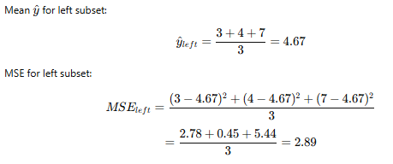
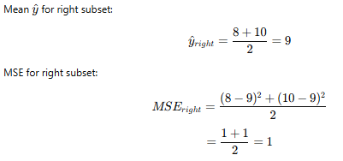
Splitting at 𝑋 = 3
Dividing into two subsets:
Left subset (X≤3): Y=[3,4,7]
Right subset (X>3): Y=[8,10]
Compute MSE for Right Subset
Compute MSE for Left Subset

Slide 17
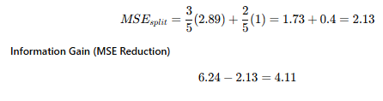
Compute Weighted MSE After Split

Slide 18

Mean Absolute Error (MAE) Split
MAE is calculated as:
where:
yi= actual value
y^​ = predicted value (mean of the subset)
N = number of samples in the subset

Slide 19
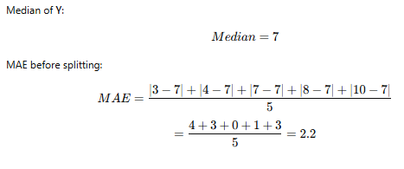
Calculate MAE Before Split
Sample Data:
Feature (X) | Target (Y)
1 | 3
2 | 4
3 | 7
4 | 8
5 | 10

Slide 20


Splitting at 𝑋=3
Left subset (X≤3): Y=[3,4,7], Median = 4
Right subset (X>3): Y=[8,10], Median = 9
Compute MAE for Left Subset
Compute MAE for Right Subset

Slide 21
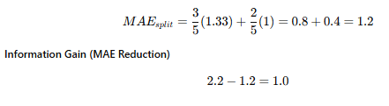
Compute MAE After Splitting
MSE favors larger errors, as squaring magnifies large deviations.
MAE is robust to outliers, as it considers absolute differences.
Decision Trees use MSE for regression tasks because it provides smoother splits.
However, MAE can be useful when the dataset has outliers.

Slide 22
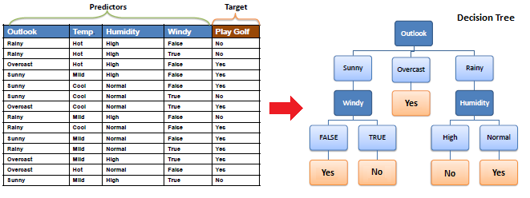
Decision Tree for Classification

Slide 23
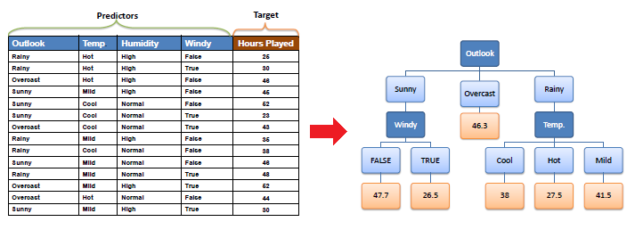
Decision Tree for Regression

Slide 24
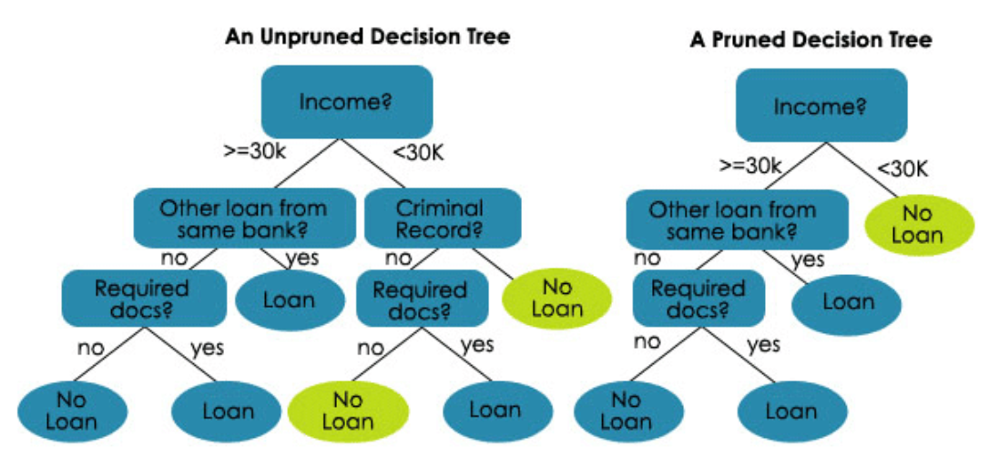
Handling Overfitting in Decision Trees
Overfitting occurs when a tree is too deep & memorizes data.
Solutions: Limit depth, Use pruning techniques, Use ensemble methods (Random Forest)

Slide 25
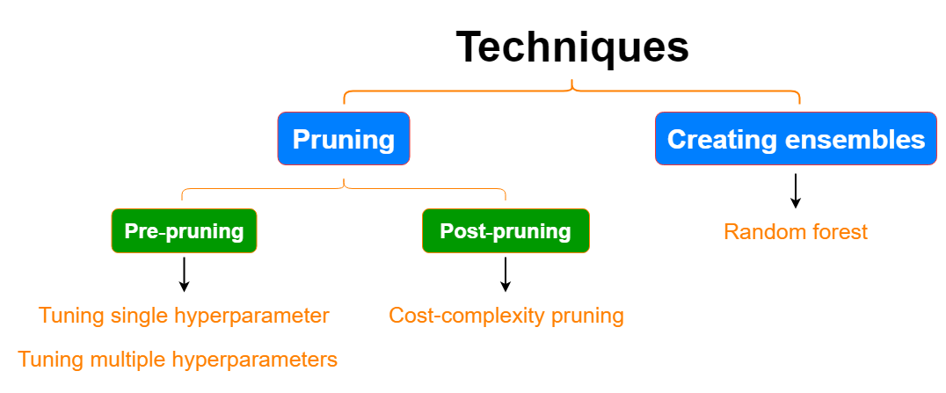
Pruning Techniques
Pre-Pruning (Early Stopping): Stop splitting when a condition is met.
Post-Pruning (Reduced Error Pruning): Remove nodes with low importance after training.

Slide 26
Advantages & Disadvantages
✅ Advantages
Handles non-linear relationships.
Works well on small datasets.
No need for feature scaling.
❌ Disadvantages
Overfitting risk.
Sensitive to small changes in data (high variance).
Not the best for highly complex patterns (better with ensemble methods).

Slide 27
Feature Importance & Hyperparameter Tuning
Feature Importance
Decision Trees help identify which features contribute most to predictions.
Feature importance is measured using Gini/Entropy (classification) or MSE (regression).
Example: In a tree predicting house prices, "size of house" might be the most important feature.
Hyperparameter Tuning :
max_depth – Limits depth of tree
min_samples_split – Minimum samples needed to split a node
min_samples_leaf – Minimum samples needed in a leaf node

Slide 28
Thank You

